Slide 1
STRING
HANDLING
IN JAVA

Slide 2
BASICS
String handling in Java refers to the process of creating, storing, manipulating, and processing strings using different classes and methods provided by Java. A string is a sequence of characters enclosed within double quotation marks, such as names, messages, addresses, and passwords.
Strings are one of the most commonly used data types in Java because almost every program works with textual data. Java provides a powerful String class along with StringBuffer class to perform various operations like concatenation, comparison, searching, replacing, and formatting of text.
Strings in Java are immutable, meaning their values cannot be changed after creation. This feature improves memory management, security, and performance. String handling is widely used in web applications, database systems, mobile apps, and software development for efficient text processing.

Slide 3
Ways of Creating a Java String
String Literal (Static Memory)
In Java, a string can be created using a string literal. A string literal is a string value written inside double quotation marks. When a string literal is created, Java stores it in a special memory area called the String Constant Pool (SCP). If the same string already exists in the pool, Java does not create a new object. Instead, it reuses the existing object. This makes Java more memory efficient.
Example
class StringPoolExample { public static void main(String args[]) { String s1 = "Java"; String s2 = "Java"; System.out.println(s1 == s2); } }

Slide 4
Ways of Creating a Java String
String Literal (Static Memory)
When s1 is created, the string "Java" is stored in the String Constant Pool.
When s2 is created, Java checks the pool and finds that "Java" already exists.
Instead of creating a new object, Java reuses the existing object.
Therefore, both s1 and s2 point to the same memory location.
s1 ──┐ ├──> "Java" s2 ──┘

Slide 5
Ways of Creating a Java String
2. Using new keyword (Heap Memory)
When a string is created using the new keyword, Java always creates a new object in heap memory, even if the same string already exists in the String Constant Pool.
Example:
String s1 = new String("Hello"); String s2 = new String("Hello");
Explanation:
s1 and s2 are created using new
Java creates two separate objects in heap memory
Therefore, both variables point to different memory locations

Slide 6
Ways of Creating a Java String
2. Using new keyword (Heap Memory)
Step 1: String s1 = new String("Hello");
(a). Check String Constant Pool
Java first checks whether "Hello" already exists in the SCP.
If not present → Java creates "Hello" in the SCP.
If already present → Java reuses it.
(b). Create New Object in Heap
Because new is used, Java creates a completely new String object in heap memory.
Step 2: String s2 = new String("Hello");
(a).Again Java checks SCP.
"Hello" already exists in SCP, So no new SCP object is created
(b). But because new is used again:
Java creates another new object in heap memory
String Constant Pool (SCP)
--------------------------
"Hello"
Heap Memory
--------------------------
Object1 -> "Hello" ← s1
Object2 -> "Hello" ← s2

Slide 7
String Constructors
String constructors are used to create String objects in different ways.
1. String from char[]
This constructor creates a string from a character array. Characters stored in array are combined A new String object is created using those characters.
Syntax
String str = new String(charArray);
Example
public class Main { public static void main(String[] args) { char ch[] = {'H','e','l','l','o'}; String s = new String(ch); System.out.println(s);}}
Output
Hello

Slide 8
String Constructors
2. String from char[] with Range
This constructor creates a string using only a specific part of the character array.
Syntax
String str = new String(charArray, start, length);
start → starting index
length → number of characters
Example
public class Main { public static void main(String[] args) { char ch[] = {'P','r','o','g','r','a','m'}; String s = new String(ch, 0, 4); System.out.println(s);}}
Output
Prog

Slide 9
String Constructors
3. String from Another String Object
This constructor creates a new string object using another string.
Syntax
String s2 = new String(s1);
Example
public class Main { public static void main(String[] args) { String s1 = "Java"; String s2 = new String(s1); System.out.println(s2);}}
Output
Java

Slide 10
String Constructors
Constructor | Purpose
String(char[]) | Creates string from full character array
String(char[], start, length) | Creates string from part of character array
String(String) | Creates new string from another string object

Slide 11
String Constructors
Method / Operator | Purpose
length() | Finds number of characters
charAt() | Returns character at specific index
concat() | Joins two strings
toUpperCase() | Converts string to uppercase
toLowerCase() | Converts string to lowercase
equals() | Compares actual contents
== | Compares memory locations
equalsIgnoreCase() | Compares without case sensitivity
compareTo() | Unicode value of each character
contains() | Checks if text exists in string
startsWith() | Checks starting characters
endsWith() | Checks ending characters
indexOf() | Finds position of character/string

Slide 12
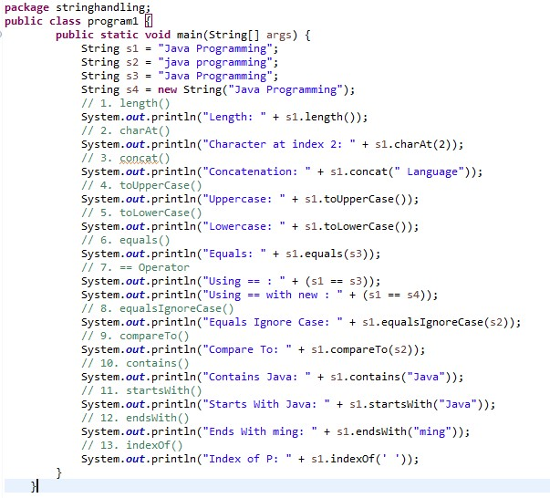

Slide 13
String Constructors
Method | Purpose
substring() | Extracts part of string
replace() | Replaces character or word
split() | Splits string into parts
trim() | Removes extra spaces
isEmpty() | Checks whether string is empty
valueOf() | Converts data type into string
toString() | Converts object into string
matches() | Checks pattern matching
join() | Joins multiple strings
replaceAll() | Replaces all matching text
replaceFirst() | Replaces first matching text

Slide 14
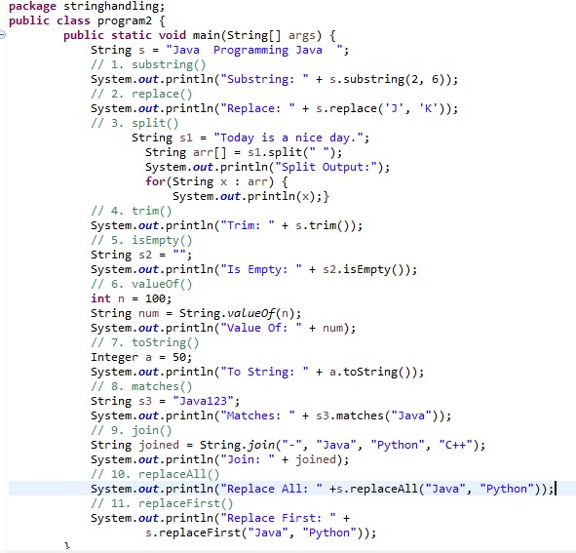

Slide 15
StringBuffer in Java
StringBuffer is a class in Java used to create mutable strings. Mutable means the content of the string can be changed without creating a new object.
It is present in:
java.lang package
Why StringBuffer is Used ????
Normal String objects are immutable.
Example: String s = "Java"; s = s.concat(" Programming");
A new object is created every time modification happens.
To avoid creating many objects and improve performance, Java provides:
StringBuffer
Creating StringBuffer Object
Syntax
StringBuffer sb = new StringBuffer("Java");

Slide 16
StringBuffer in Java
Method | Purpose
append() | Adds text at end
insert() | Inserts text
replace() | Replaces text
delete() | Deletes part of string
reverse() | Reverses string
capacity() | Returns buffer capacity
length() | Returns length
charAt() | Returns character
setCharAt() | Changes character
substring() | Extracts substring

Slide 17
